Slide 1
EXCEL DASHBOARD
Prepared by: Pavithra L
Data Analytics
Notes:
Good morning everyone. My name is Pavithra L, and today I will be presenting the Samsung Galaxy 5G Market and Sales Dashboard, covering the period from 2019 to 2024.

Slide 2
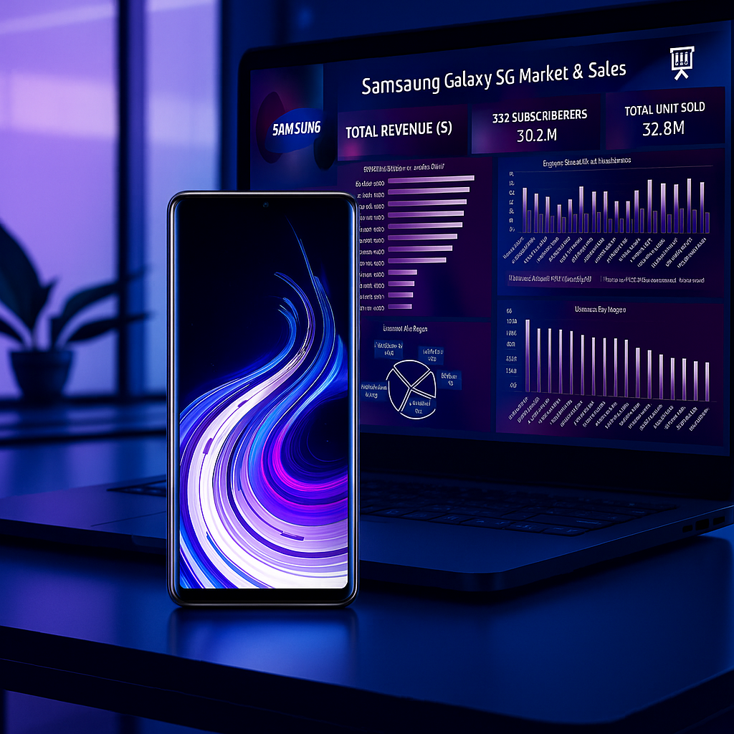
Introduction
Samsung Galaxy 5G Market & Sales Dashboard (2019–2024)
This project focuses on understanding Samsung’s performance in the 5G smartphone market. Samsung is one of the world’s leading smartphone brands, and the global adoption of 5G has increased significantly from 2019 to 2024.

Slide 3

Objectives
Identify top-performing 5G smartphone models
Analyze revenue distribution across regions
Compare 5G vs Non-5G preference
Study sales trends over years and quarters
Understand impact of 5G coverage and speed on
User adoption
Notes:
The objective of this dashboard is to understand Samsung’s 5G performance. We focus on five key areas:
Top-performing 5G smartphone models
Revenue distribution across global regions
User preference for 5G vs Non-5G
Sales trends across years and quarters
The impact of network coverage and speed on customer adoption.

Slide 4

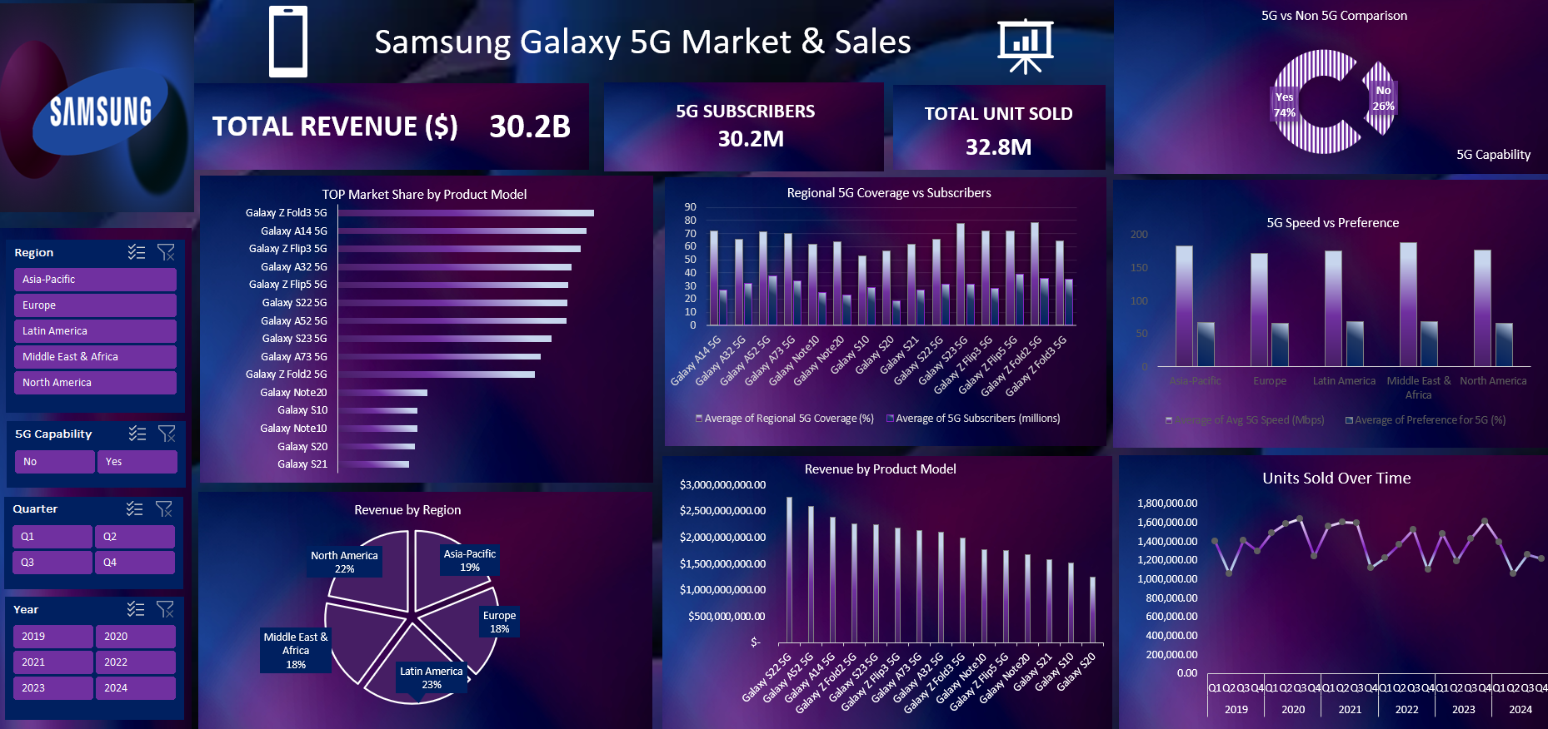

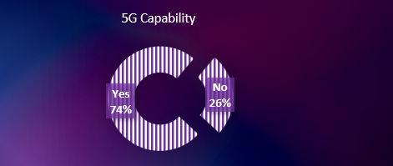
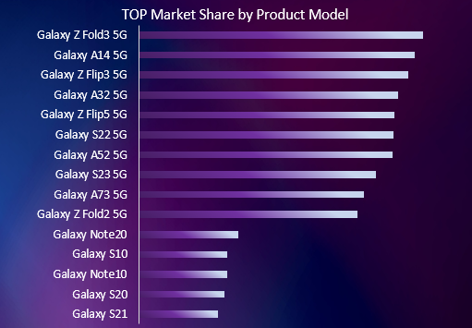
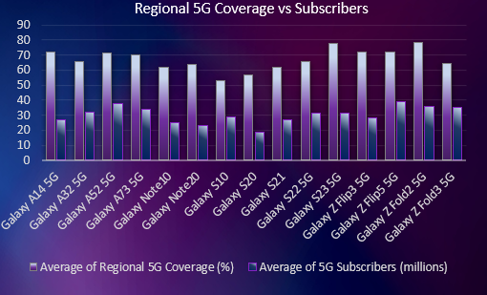
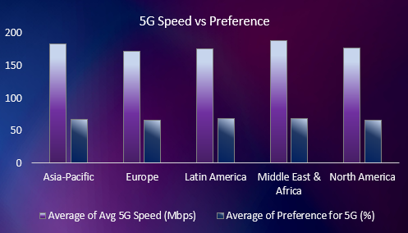
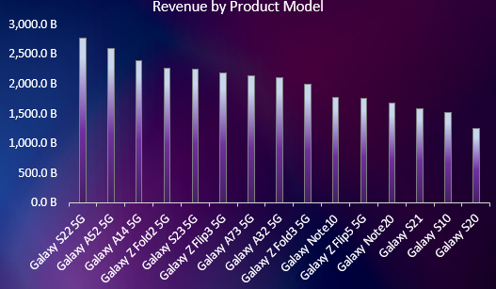
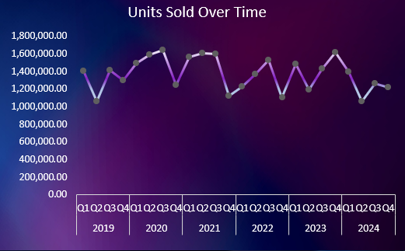
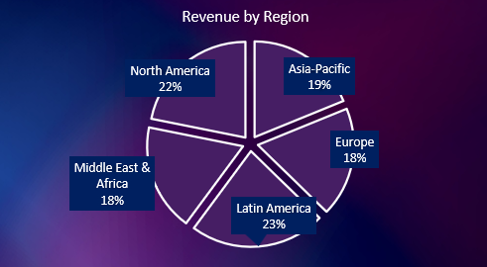
Notes:
This is the complete dashboard. It is fully interactive with filters for region, year, quarter, and 5G capability.”

Slide 5

KPI
TOTAL REVENUE ($)
30.2B
5G SUBSCRIBERS
30.2M
TOTAL UNIT SOLD
32.8M
KPIs give a high-level business summary
Notes:
Our key metrics show a total revenue of 30.2 billion dollars, 30.2 million 5G subscribers, and 32.8 million units sold. These KPIs provide a high-level business summary.”

Slide 6
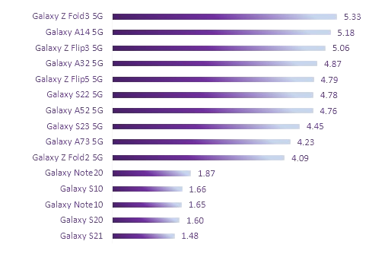
TOP Market Share by Product Model
Galaxy Z Fold3 5G → Highest market share
A-series and Flip-series also strong
Shows performance of individual 5G models
Helps identify top-selling devices
Notes:
From the product model comparison, the Galaxy Z Fold3 5G holds the highest market share. A-series and Flip-series devices also show strong performance. This chart helps us identify the most successful Samsung 5G models.”

Slide 7
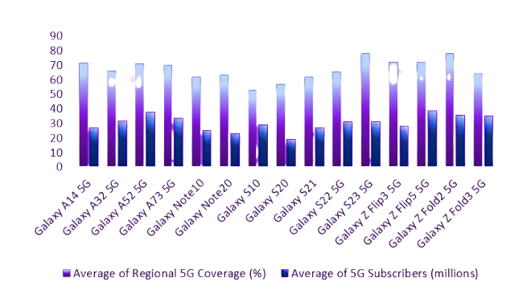
Regional 5G Coverage vs Subscribers
Comparison between average 5G coverage
And number of 5G subscribers
Shows how network availability impacts adoption
Regions with strong 5G coverage have higher users
Notes:
This chart compares regional 5G coverage with the number of subscribers. We observe that regions with higher coverage also have higher adoption. This shows that strong network availability directly influences 5G user growth

Slide 8
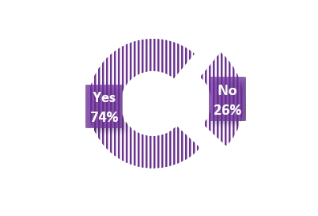
5G Capability
74% users prefer 5G devices
Only 26% still use Non-5G
Indicates strong global shift toward 5G technology
Notes:
Here we can see a clear shift toward 5G devices. 74% of users prefer 5G, while only 26% use Non-5G. This indicates a global move towards next-generation connectivity.”

Slide 9
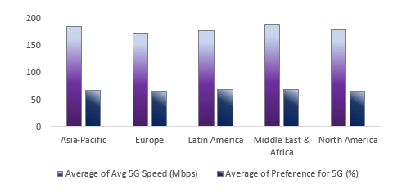
5G Speed vs Preference
Higher 5G speeds → Higher customer preference
North America & Middle East perform strongly
Shows technology quality influences buying decisions
Notes:
This chart shows how speed influences preference. North America and the Middle East perform strongly, with high speeds and high user preference. This indicates that technology quality directly affects customer buying decisions.”

Slide 10
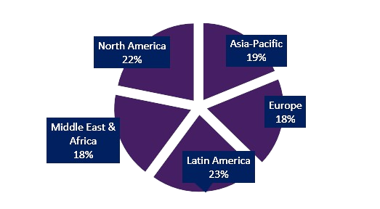
Revenue by Region
Shows global revenue distribution
Notes:
Revenue distribution shows Latin America and North America as major contributors. Asia-Pacific, Europe, and the Middle East also show balanced revenue performance.”

Slide 11
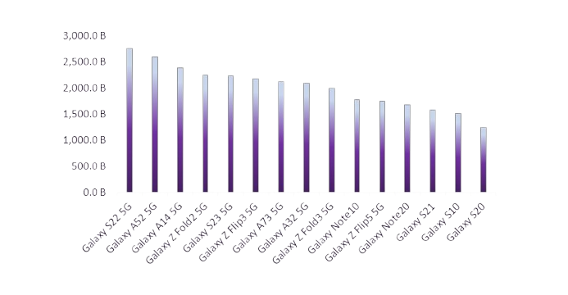
Revenue by Product Model
Fold & Flip series dominate revenue
A-series contributes stable mid-range sales
Premium + budget combination benefits Samsung
Notes:
Fold and Flip series dominate revenue. The A-series contributes consistent mid-range sales. Overall, Samsung benefits from both premium and budget mo

Slide 12
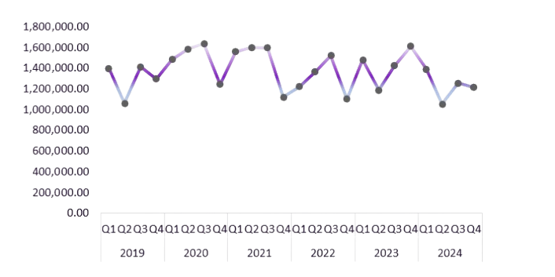
Units Sold Over Time
Sales performance from 2019 to 2024
Peaks during Q3–Q4 each year
Reflects festival/holiday season trends
Notes:
This time-series chart shows sales from 2019 to 2024. Sales peak consistently during the third and fourth quarters, indicating strong demand during festival or holiday seasons.

Slide 13
Major Insights
Strong global shift toward 5G smartphones
Fold, Flip, and A-series models are top performers
Latin America & North America → major revenue contributors
Network quality affects customer preference
Sales peak consistently in the second half of each year
Notes:
In summary, we see a strong global shift toward 5G smartphones. Fold, Flip, and A-series models perform the best. Network coverage and speed significantly impact adoption. Sales show a seasonal peak pattern across years.”

Slide 14
Recommendations
Increase focus on Fold & Flip series due to high revenue contribution
Improve 5G network partnerships in regions with low coverage
Enhance 5G speed in emerging markets to increase user adoption
Target Q3–Q4 with aggressive marketing strategies
Expand presence in Latin America & North America markets
Introduce budget-friendly 5G models to shift remaining Non-5G users
Improve post-purchase experience and software updates for premium devices

Slide 15
Conclusion
Dashboard gives a complete picture of Samsung 5G performance
Useful for marketing, sales, and strategy teams
Shows clear patterns in revenue, sales, and user preference
Helps guide future business decisions
Notes:
This dashboard gives a complete picture of Samsung’s 5G performance and is useful for marketing, sales, and business strategy teams.”

Slide 16
Thank you

